Slide 1



Navigating Scholarly Publishing:
An Introduction to the Asian Council of Science Editors and Latest Updates
Ms. Maryam Sayab (she/her)
Director of Communications
Asian Council of Science Editors
Dubai, UAE

Slide 2

ABOUT THE
COUNCIL
  Founded in 2013
  Nonprofit
  Internationally oriented
  Connecting Communities
  Promote best practices
  Provide intelligent information and technical solutions.

Slide 3





MISSION
Connecting professionals across the globe while concentrating precisely on the publishing industry and inducing capacity building with specialized training
EDUCATE
ENGAGE
VISION
Being the most reliable solution providing organization to the Asian scholarly publishing community
EXCHANGE
EMPOWER

Slide 4




GEOGRAPHICAL VARIATIONS IN SCHOLARLY PUBLISHING
DEVELOPED COUNTRIES
ASIA
CAPACITY BUILDING
FUNDING & RESOURCES
TECHNOLOGICAL SOLUTIONS

Slide 5
GEOGRAPHICAL VARIATIONS IN SCHOLARLY PUBLISHING
DEVELOPED COUNTRIES
ASIA
  Regulatory Bodies
  Regulatory Bodies
CAPACITY BUILDING
FUNDING & RESOURCES
TECHNOLOGICAL SOLUTIONS

Slide 6
GEOGRAPHICAL VARIATIONS IN SCHOLARLY PUBLISHING
DEVELOPED COUNTRIES
ASIA
  Regulatory Bodies
  Established research & publishing ecosystems
  Regulatory Bodies
  Underdeveloped research & publishing ecosystems
CAPACITY BUILDING
FUNDING & RESOURCES
TECHNOLOGICAL SOLUTIONS

Slide 7
GEOGRAPHICAL VARIATIONS IN SCHOLARLY PUBLISHING
DEVELOPED COUNTRIES
ASIA
  Regulatory Bodies
  Established research & publishing ecosystems
  Advanced Infrastructure
  Regulatory Bodies
  Underdeveloped research & publishing ecosystems
  No specific Infrastructure
CAPACITY BUILDING
FUNDING & RESOURCES
TECHNOLOGICAL SOLUTIONS

Slide 8
GEOGRAPHICAL VARIATIONS IN SCHOLARLY PUBLISHING
DEVELOPED COUNTRIES
ASIA
  Regulatory Bodies
  Established research & publishing ecosystems
  Advanced Infrastructure
  Availability of Funding & Resources
  Regulatory Bodies
  Underdeveloped research & publishing ecosystems
  No specific Infrastructure
  Lack of Funding & Resources
CAPACITY BUILDING
FUNDING & RESOURCES
TECHNOLOGICAL SOLUTIONS

Slide 9
GEOGRAPHICAL VARIATIONS IN SCHOLARLY PUBLISHING
DEVELOPED COUNTRIES
ASIA
  Regulatory Bodies
  Established research & publishing ecosystems
  Advanced Infrastructure
  Availability of Funding & Resources
  Prestigious journals with
high-impact factors
  Regulatory Bodies
  Underdeveloped research & publishing ecosystems
  No specific Infrastructure
  Lack of Funding & Resources
  Predatory & inactive society journals
CAPACITY BUILDING
FUNDING & RESOURCES
TECHNOLOGICAL SOLUTIONS

Slide 10
GEOGRAPHICAL VARIATIONS IN SCHOLARLY PUBLISHING
DEVELOPED COUNTRIES
ASIA
  Regulatory Bodies
  Established research & publishing ecosystems
  Advanced Infrastructure
  Availability of Funding & Resources
  Prestigious journals with
high-impact factors
  Often published in English
  Regulatory Bodies
  Underdeveloped research & publishing ecosystems
  No specific Infrastructure
  Lack of Funding & Resources
  Predatory & inactive society journals
  Language Barriers
CAPACITY BUILDING
FUNDING & RESOURCES
TECHNOLOGICAL SOLUTIONS

Slide 11
GEOGRAPHICAL VARIATIONS IN SCHOLARLY PUBLISHING
DEVELOPED COUNTRIES
ASIA
  Regulatory Bodies
  Established research & publishing ecosystems
  Advanced Infrastructure
  Availability of Funding & Resources
  Prestigious journals with
high-impact factors
  Often published in English
  Well equip and centralized Ethics and Quality Control
  Regulatory Bodies
  Underdeveloped research & publishing ecosystems
  No specific Infrastructure
  Lack of Funding & Resources
  Predatory & inactive society journals
  Language Barriers
  Individual Ethics and Quality Control
CAPACITY BUILDING
FUNDING & RESOURCES
TECHNOLOGICAL SOLUTIONS

Slide 12

Advanced Manuscript Submission & Peer Review System
A reliable and stable editorial system developed by ACSE to facilitate the society journals and scholarly publishers in bringing qualitative content to the scientific community.
scione.com

Slide 13
EXPERIENCE LEGITIMATE PUBLISHING WITH SCIONE!
Developed, Designed & Dedicated to Scholarly Publishing Community
Web & Hosting
Publication
& Promotion
Economic
Rigorous
Peer Review
Production
& Layout
Instant
Manuscript
Submission &
Management
Fast
Efficient
Easy

Slide 14
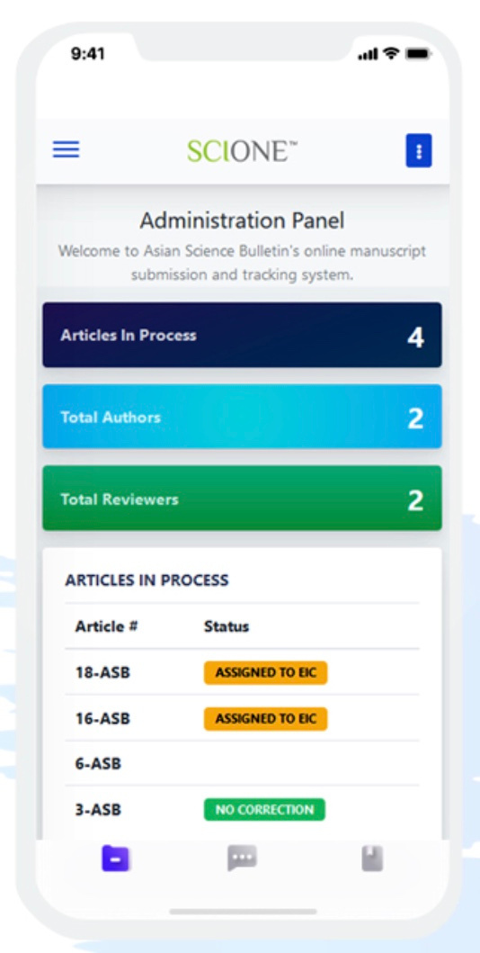
SCIONE Mile-stones
2020
SCIONE was
Launched
2021
Modified as per regional demands of members
2022
Customizable portable
2023
90+ Society Journal Subscribers enjoying SCIONE
2024
Expanding to host 500+ Journals

Slide 15





PROMOTE ETHICS
DEVELOP RESOURCES
COUNCIL'S
STRATEGY
WHAT WE
DO!
CAPACITY BUILDING
CONNECT PROFESSIONALS

Slide 16


We are in
Numbers
6K+
500+
95%
Individual Members
Industry Linkages
of member's satisfaction

Slide 17

Goals to Achieve & Struggle For!
Elevate
Asian Scholarly Publishing Standards
Foster
Global Research Collaboration
Empower
Diversity in Knowledge Dissemination
Advocate
Ethics and Integrity in Publishing

Slide 18

At ACSE We Believe in
Community Driven Council!

Slide 19

Thank
You
Get inTouch!
Email: maryamsayab@theacse.com
Phone: +971-50-925-3308
Website: www.theacse.com

